Slide 1
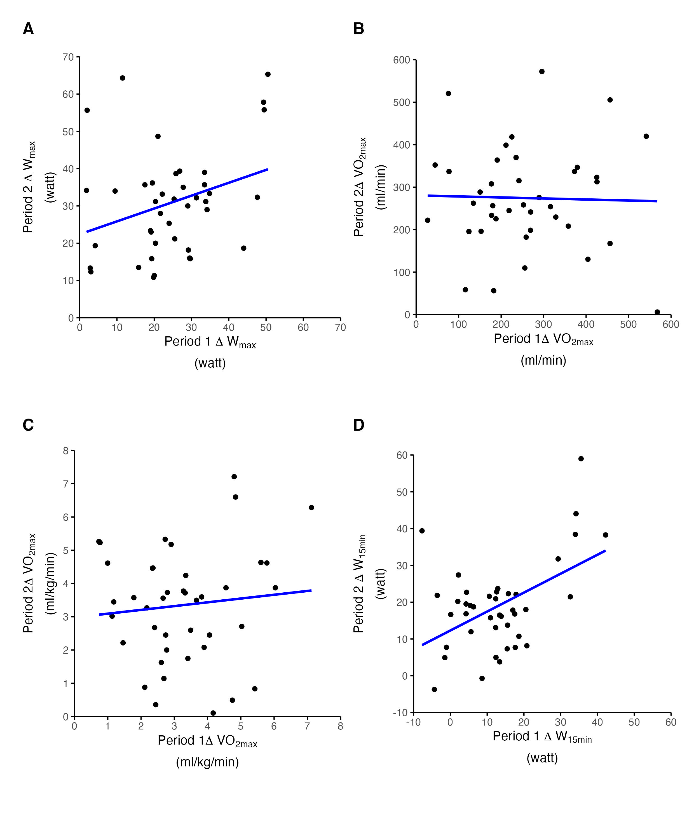
ICC = 0.38 [0.13, 0,59]
ICC = 0.20 [0, 0.47]
CV = 41.31
CV = 48.68
ICC = 0.12 [0, 0.34]
ICC = 0.25 [0, 0.55]
CV = 48.79
CV: 69.13

Slide 2
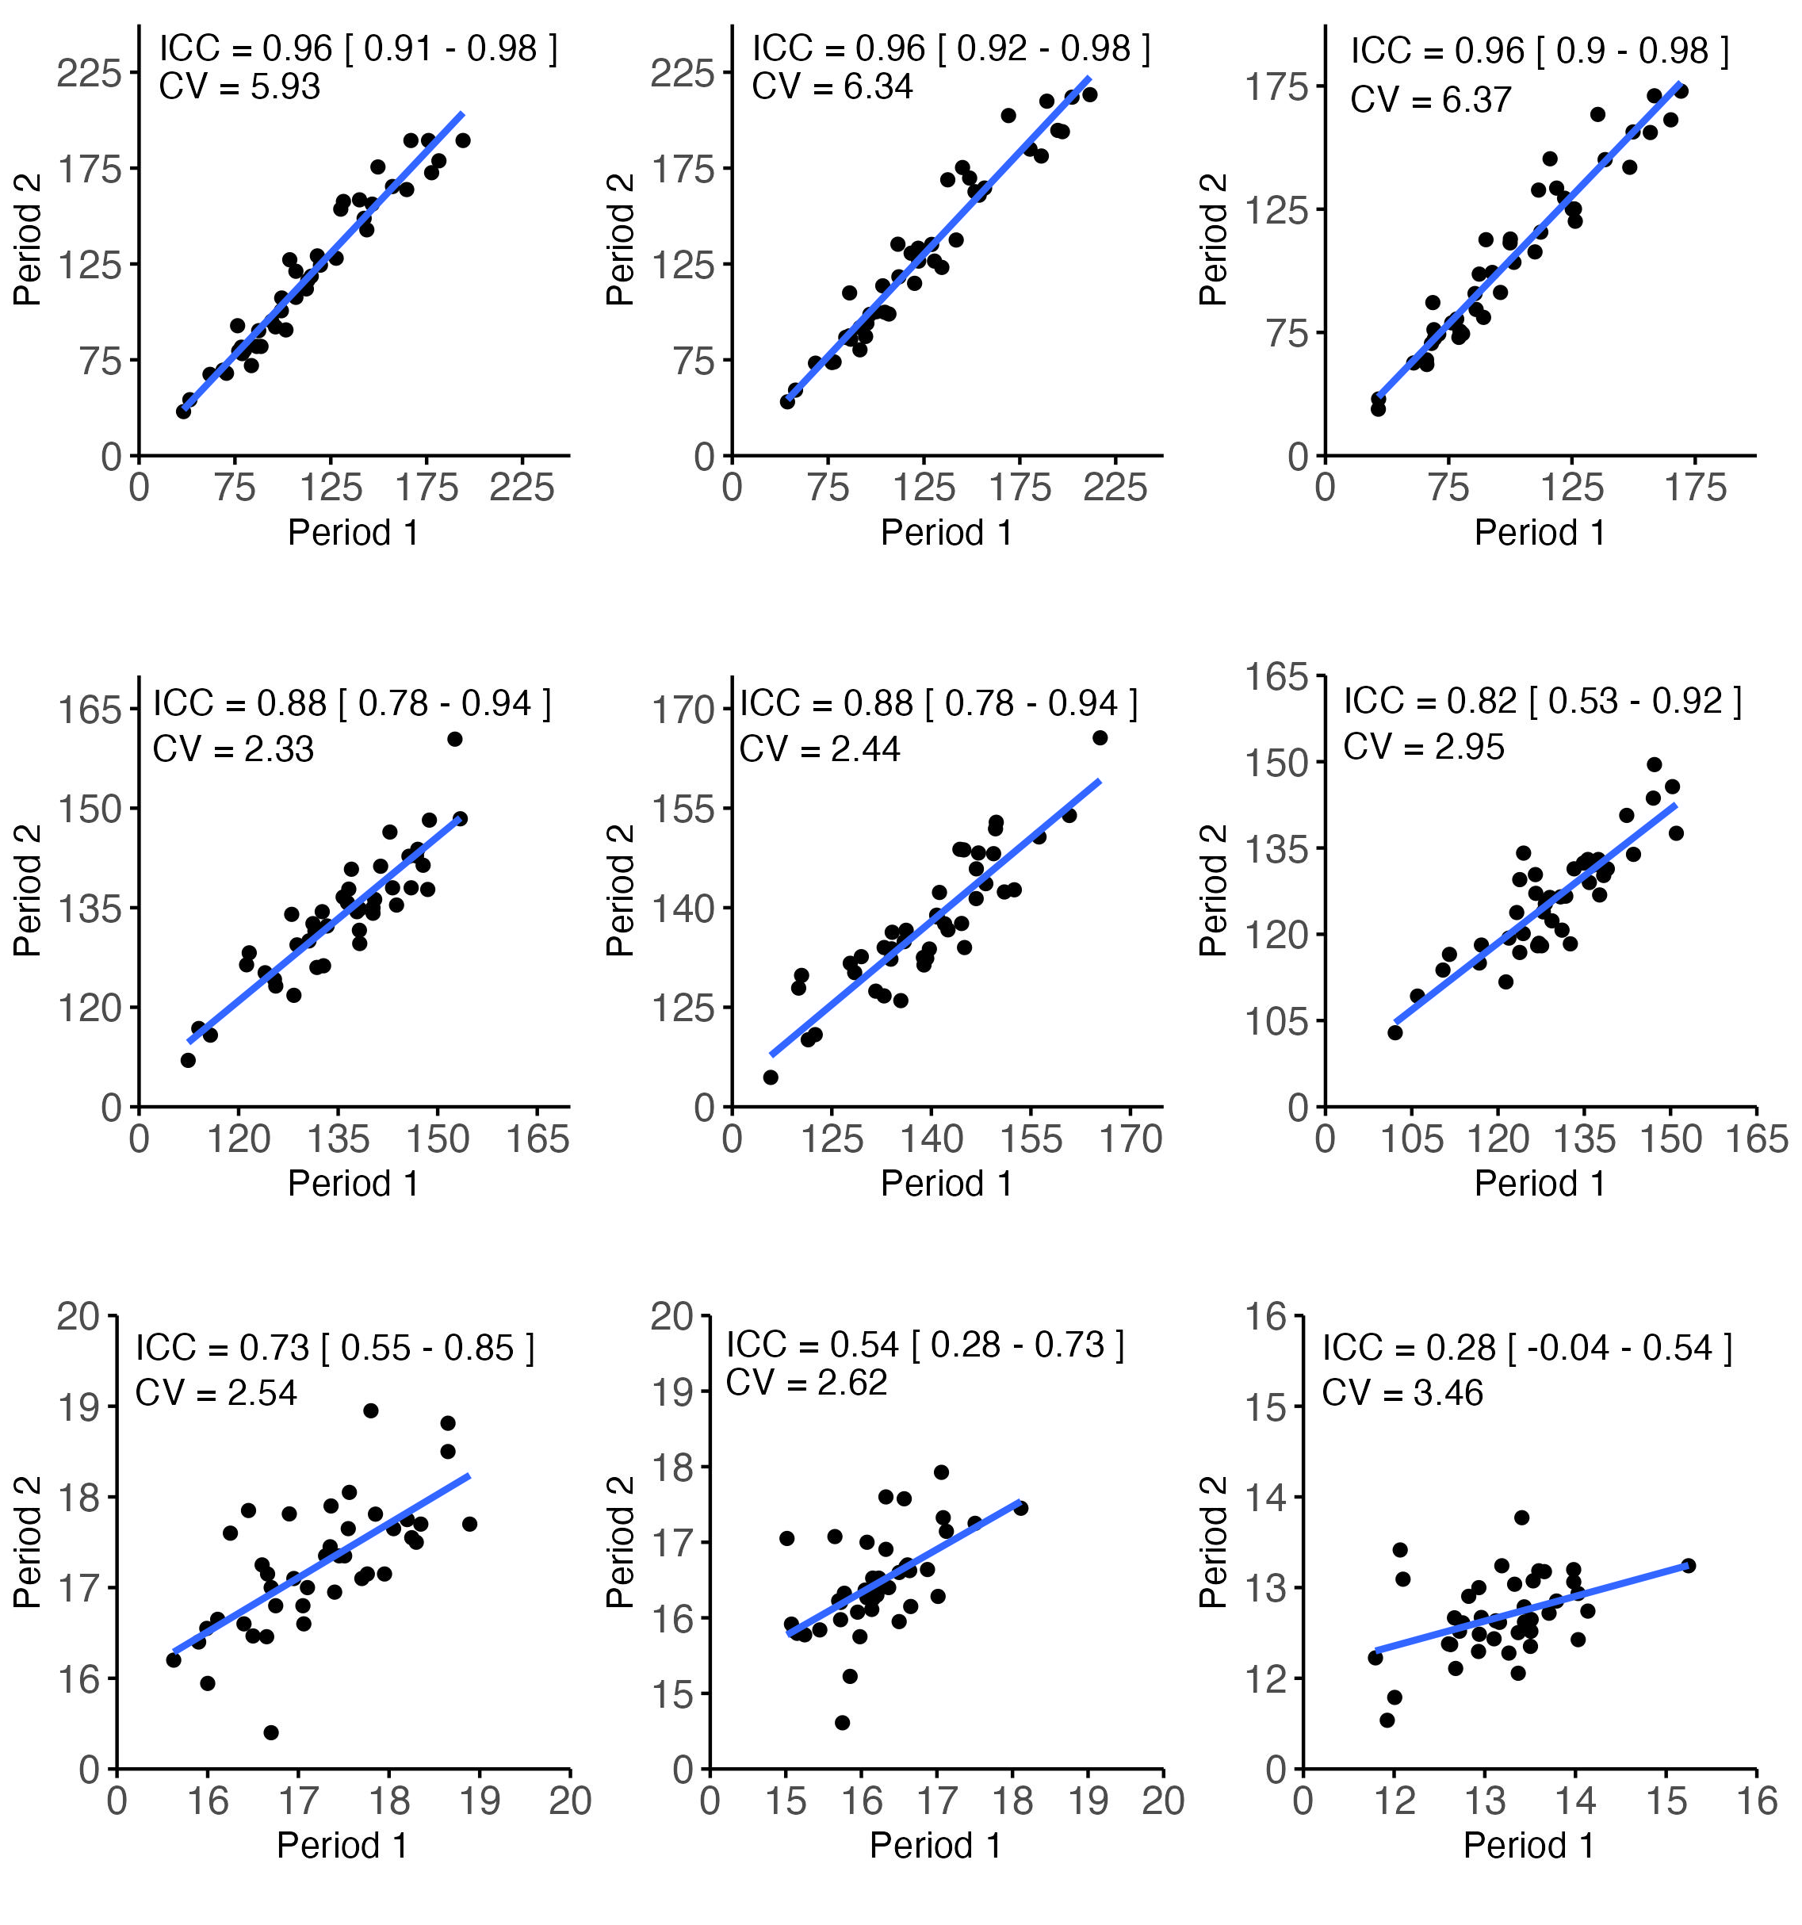
A
4x5 min
B
4x8 min
C
6x6 min
,
,
,
Watt
D
E
F
,
,
,
Heart rate
G
H
I
,
,
,
RPE

Slide 3
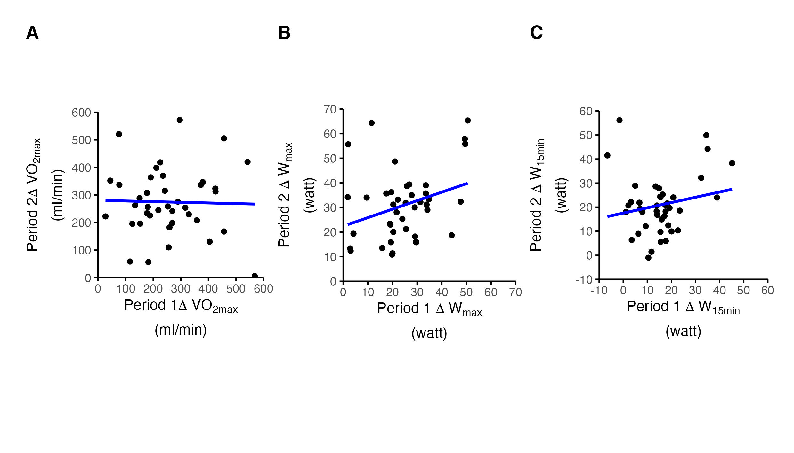
ICC = 0.20 [0, 0.47]
ICC = 0.38 [0.13, 0,59]
ICC = 0.25 [0, 0.55]
CV = 48.68
CV = 41.31
CV: 69.13

Slide 4
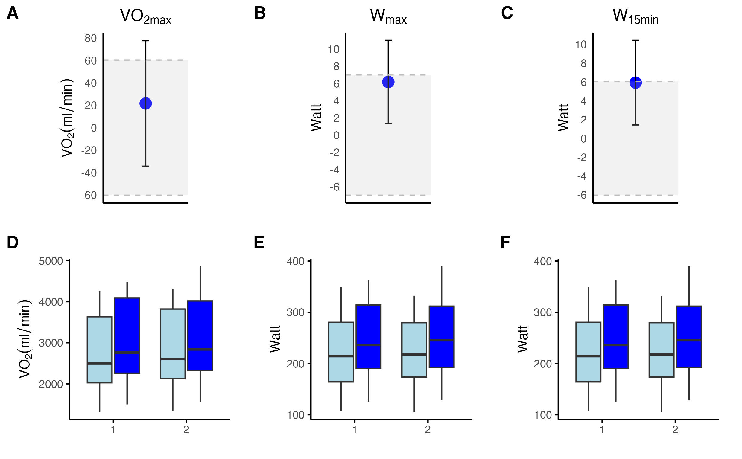
Difference in mean change scores between P1 and P2
Pre Vs. Post in P1 and P2
Period
Period
Period
Pre
post

Slide 5
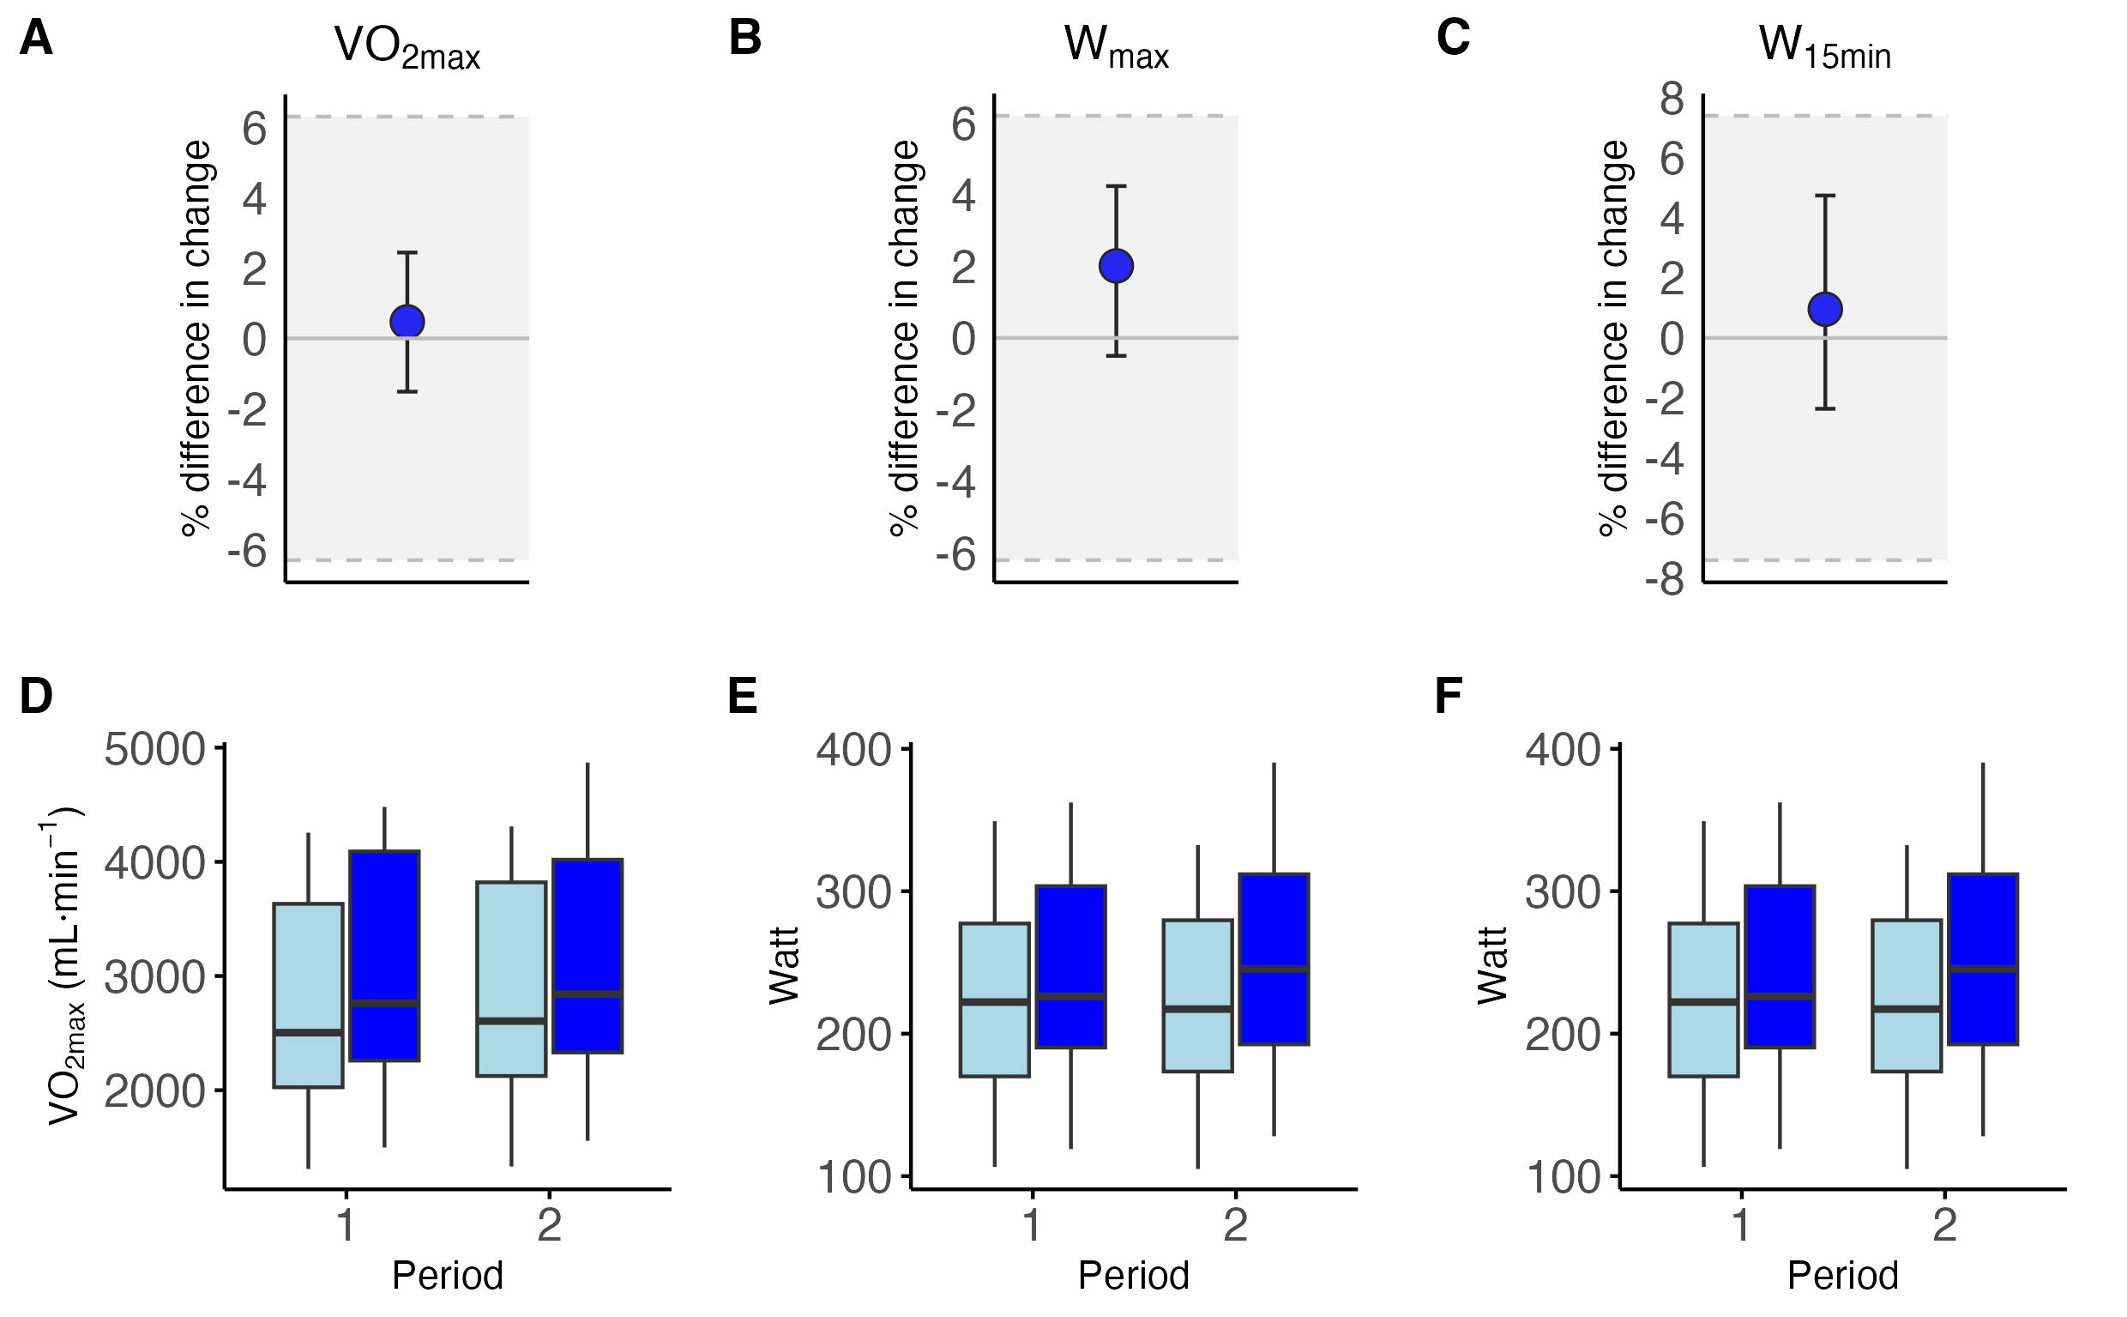
Pre
post

Slide 6
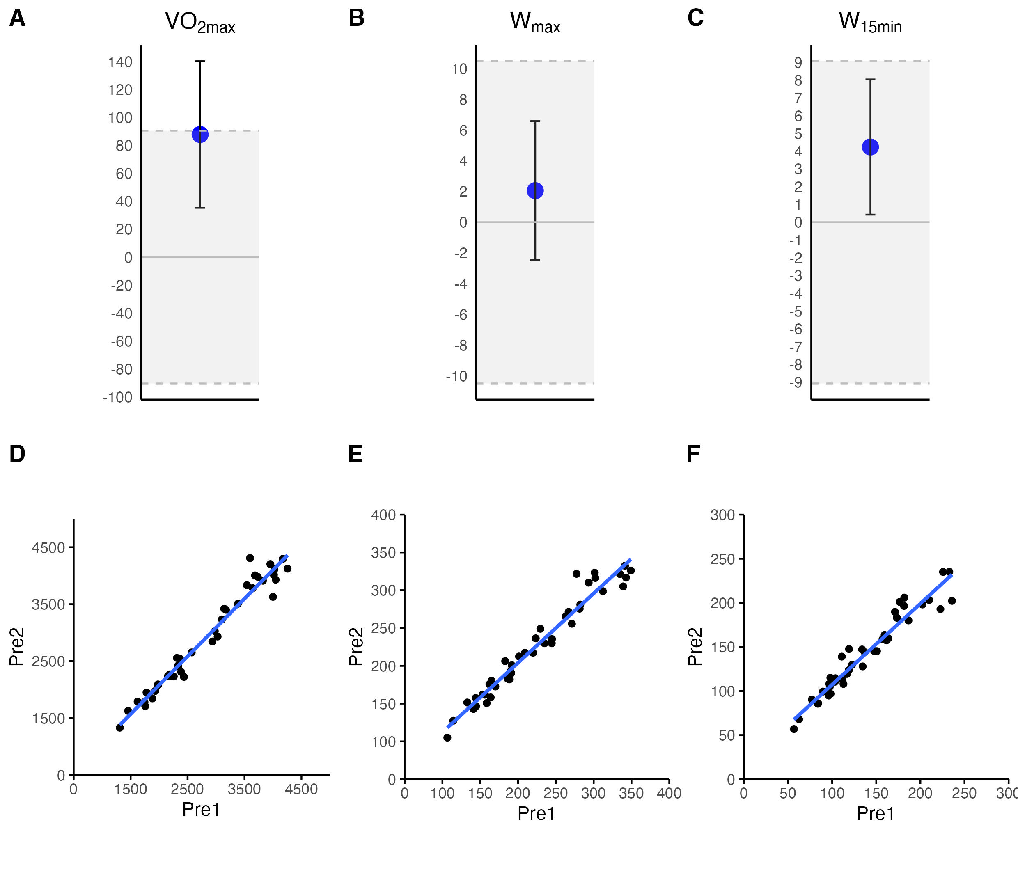
Difference in mL/min^{–1}
Difference in watt
Difference in watt
ICC = 0.98 [0.96, 0.99]
ICC = 0.98 [0.96, 0.99]
ICC = 0.96 [0.92, 0.98]
CV = 4.28
CV = 4.64
CV = 6.80

Slide 7
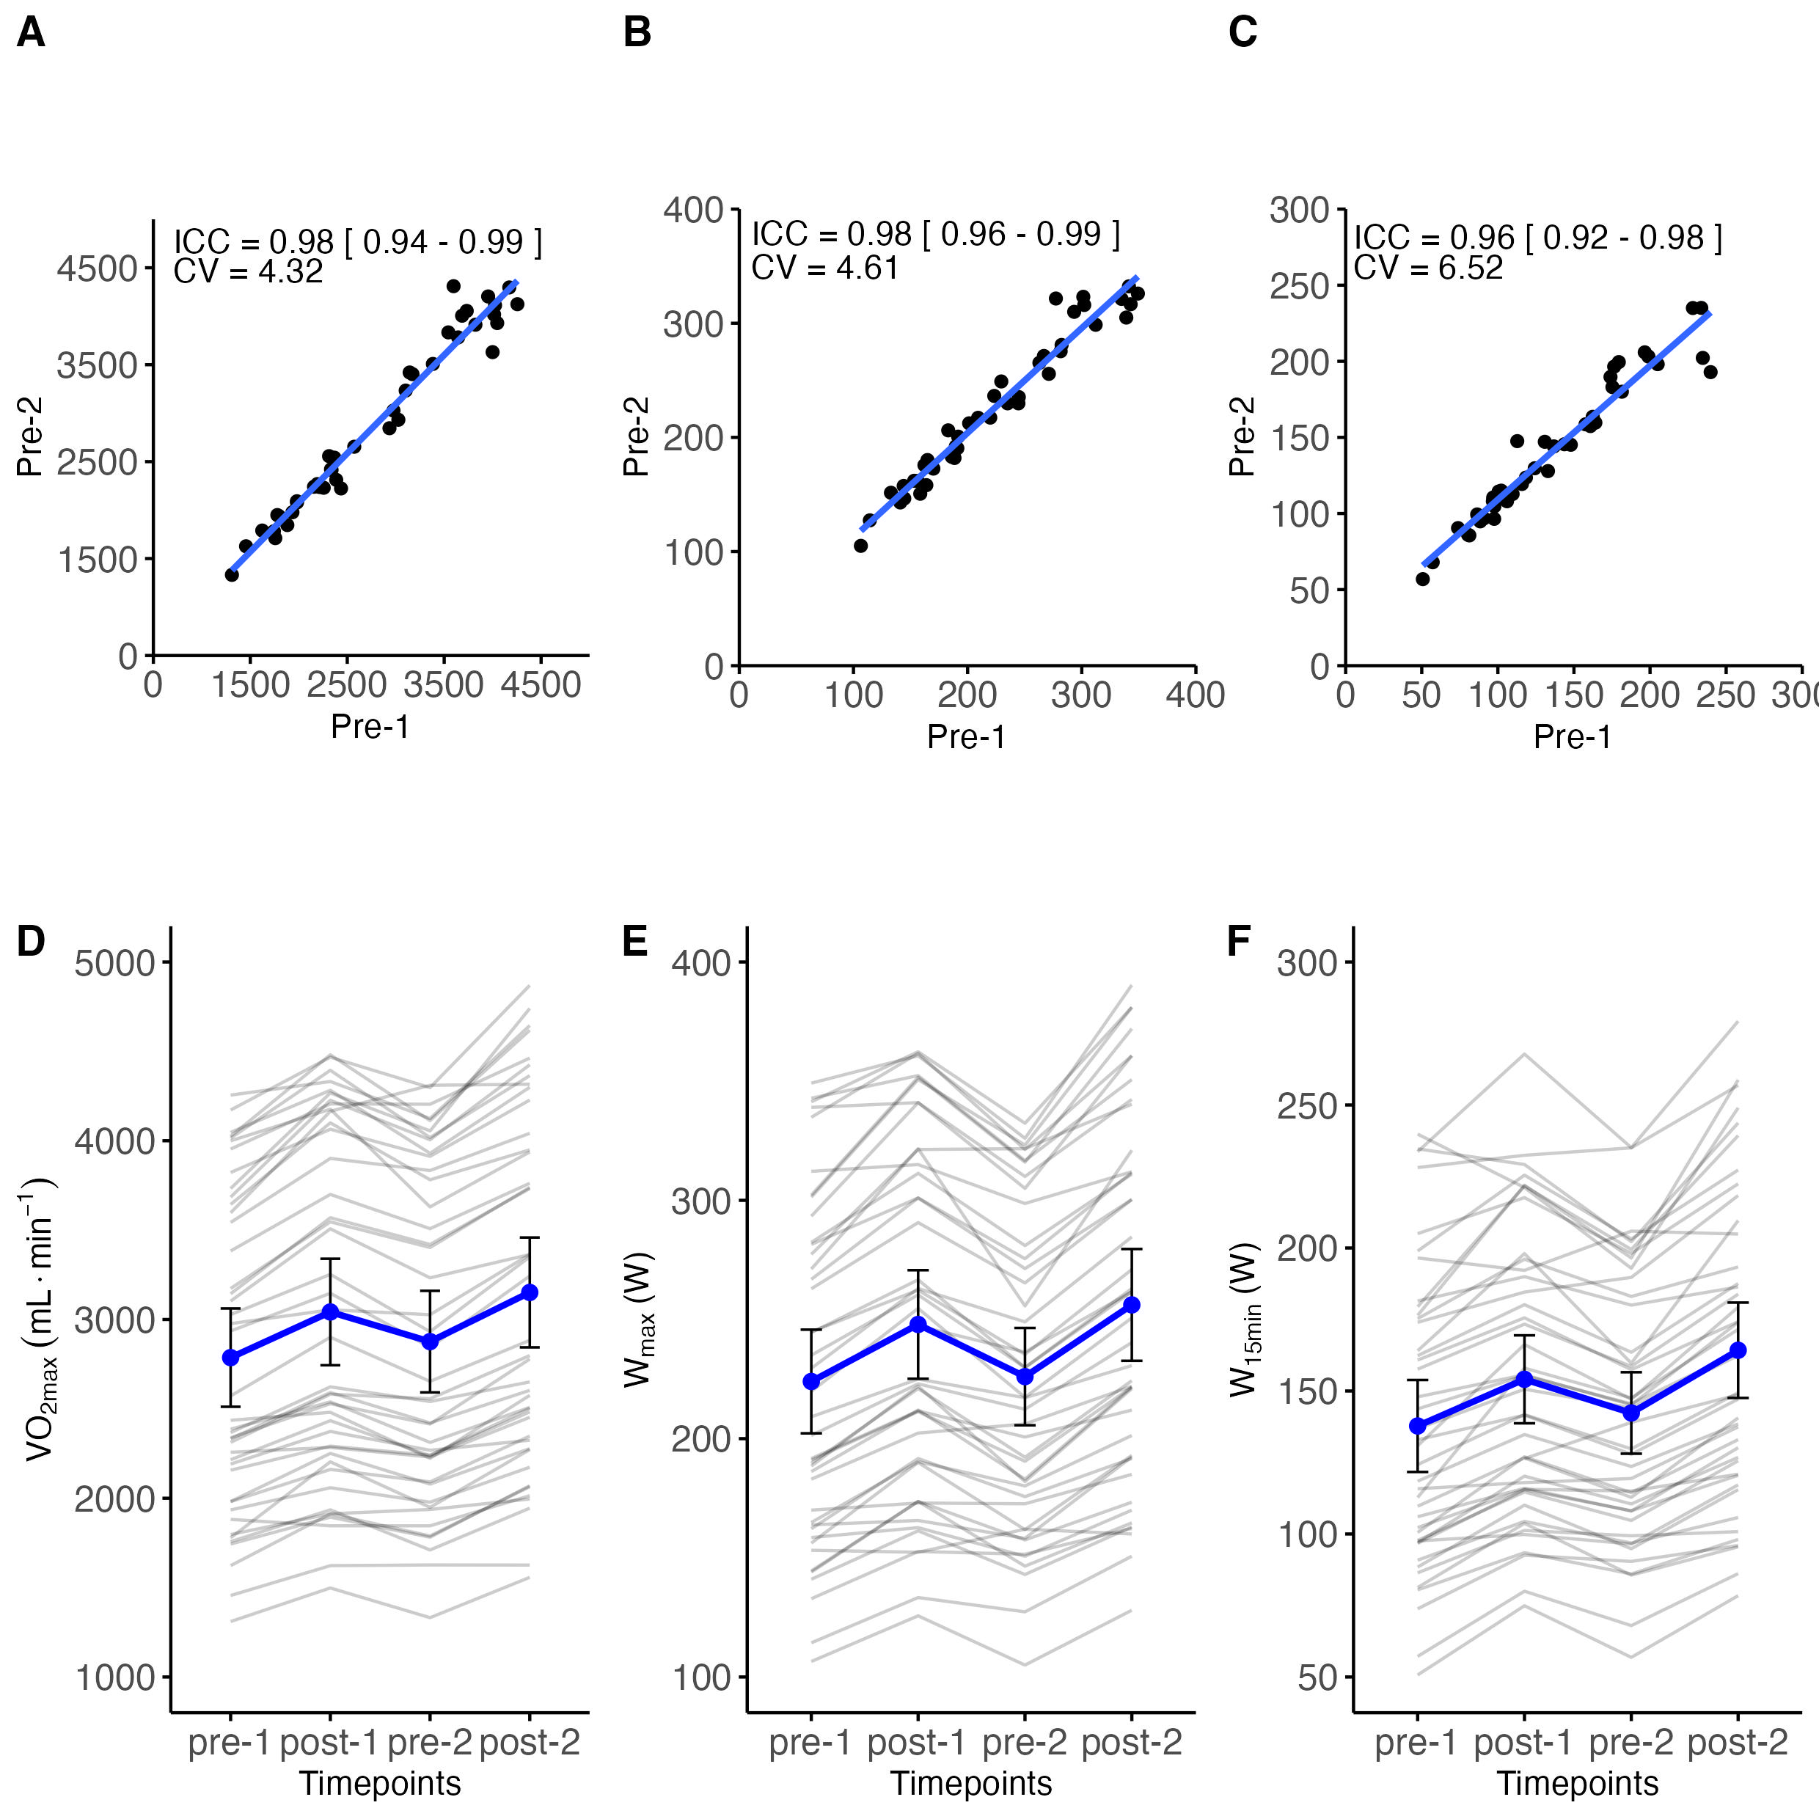
V̇O2_{max} (mL∙ min^{–1} )
W_{max} (W)
W_{15min} (W)
,
,
,

Slide 8
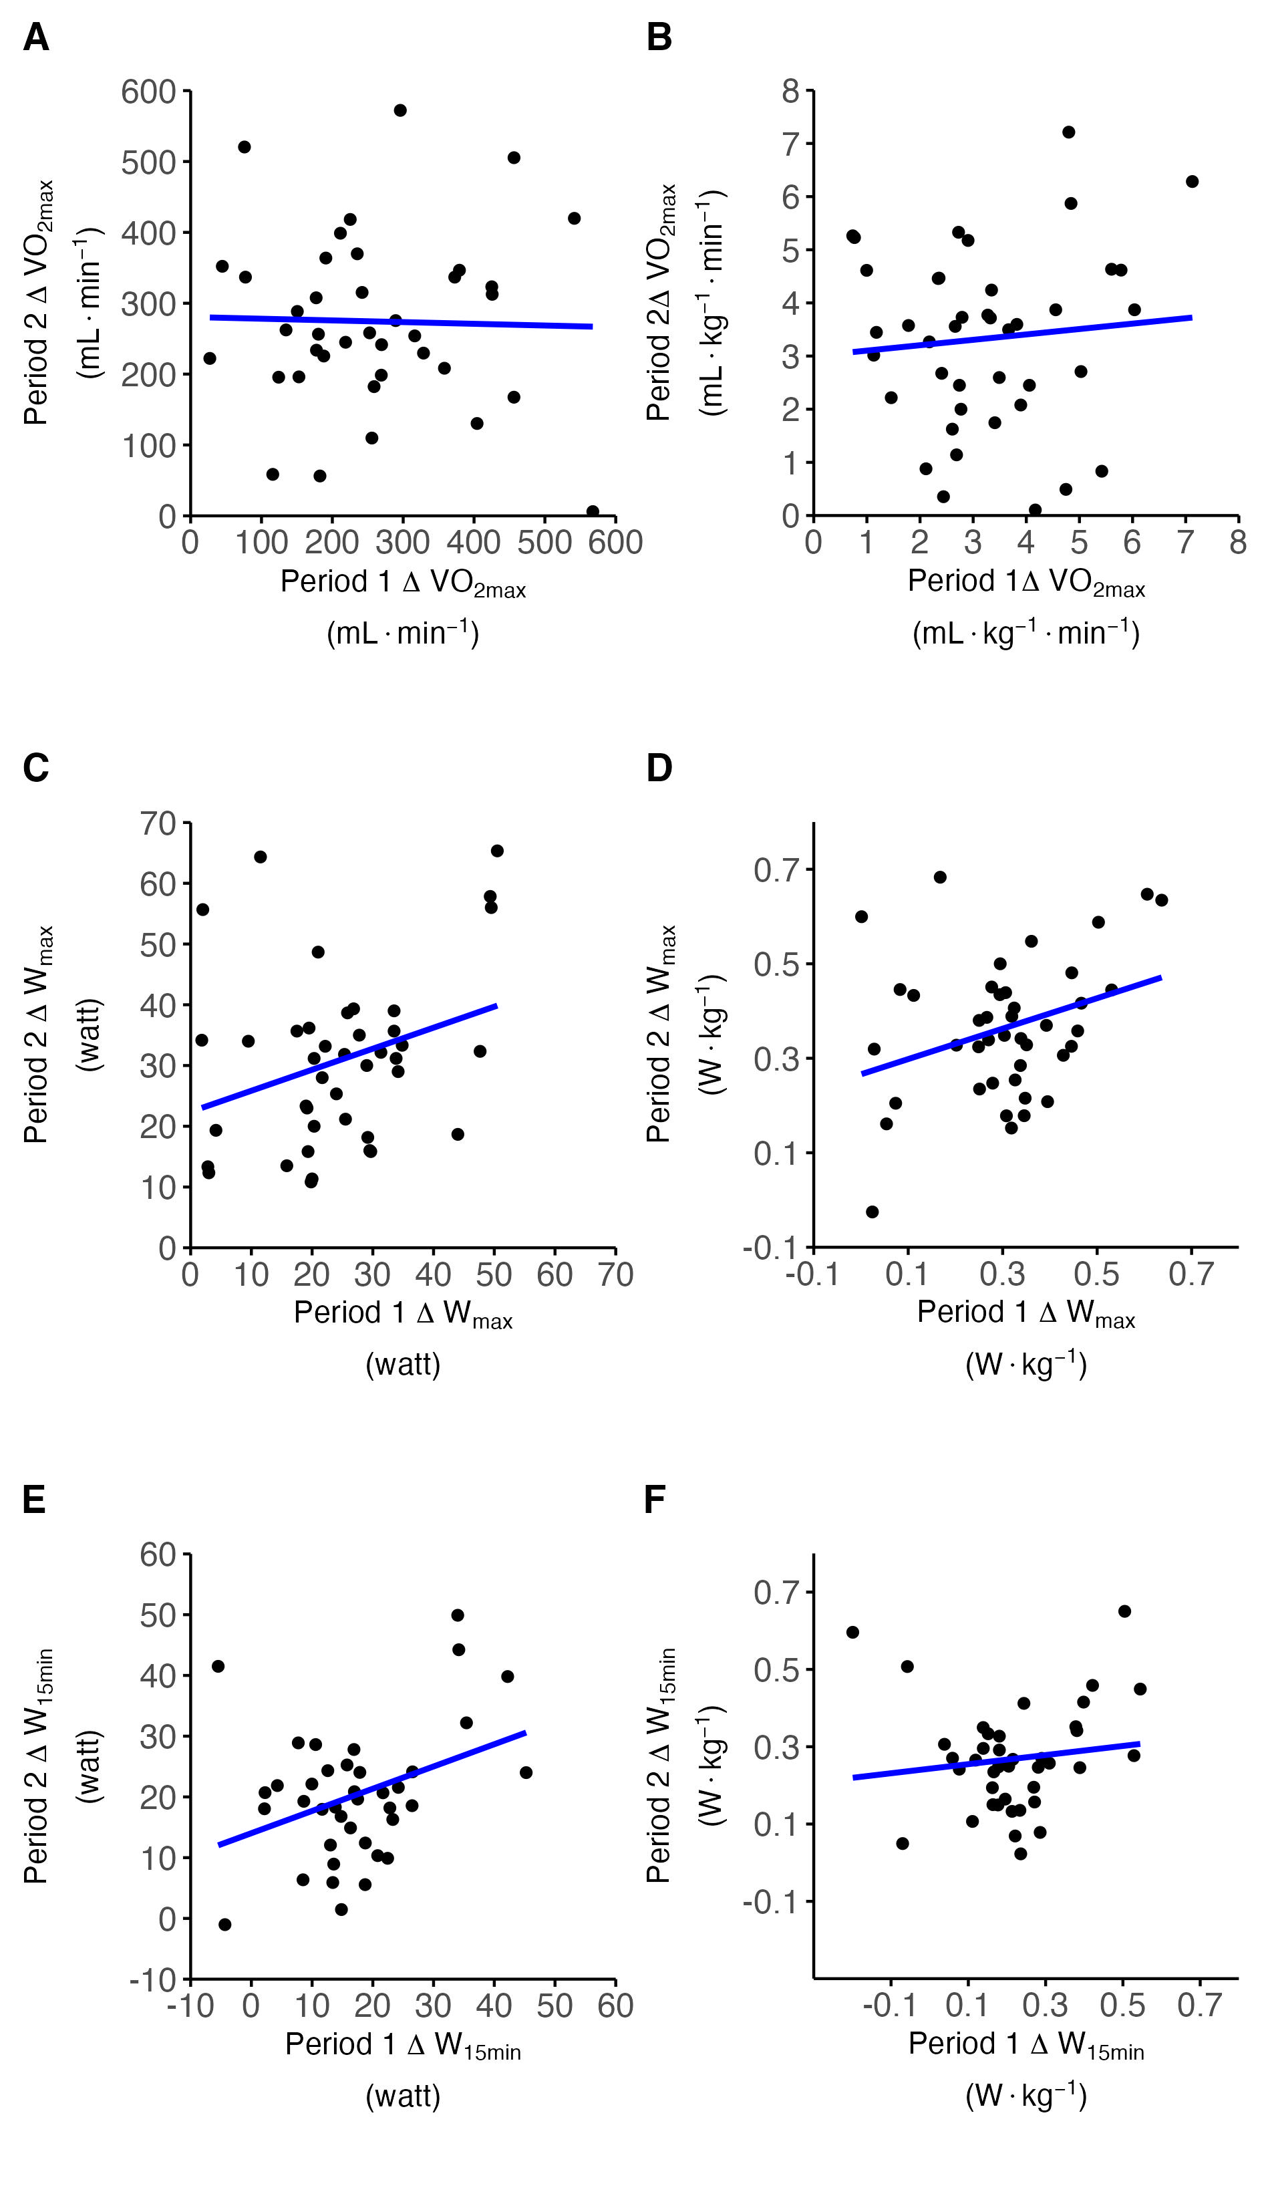
ICC = 0.19 [-0.12, 0.46]
r = 0.19 [-0.13, 0.46]
ICC = 0.12 [-0.20, 0.41]
r = 0.12 [-0.20, 0.41]
ICC = 0.35 [0.07, 0.58]
r = 0.38 [0.08, 0.61]
ICC = 0.30 [0.02, 0.55]
r = 0.32 [0.02, 0.57]
ICC = 0.22 [-0.07, 0.48]
r = 0.23 [-0.08, 0.5]
ICC = 0.12 [-0.17, 0.41]
r = 0.13 [-0.18, 0.42]

Slide 9
ICC = 0.19 [-0.12, 0.46]
ICC = 0.12 [-0.20, 0.41]
ICC = 0.35 [0.07, 0.58]
ICC = 0.30 [0.02, 0.55]
ICC = 0.22 [-0.07, 0.48]
ICC = 0.12 [-0.17, 0.41]

